Slide 1
Class 4: Data Manipulation with Pandas
MGSC 310
Ben Labaschin

Slide 2
Class 4: Outline
👈
Tufte article discussion
“Tidy” data
Data manipulation with pandas
Pandas lab

Slide 3
Tufte Article Discussion
What did you like about the Tufte article? Cite specific events
What criticisms did you have of the article?
How could we relate the events of Tufte’s article to the Covid-19 pandemic?
Notes:
notes: good visual data analysis can be some of the most effective arguments we can make
but just like in the challenger explosion, when viewers are incentivized to doubt, they often will.
determine your role when you are making a visual: are you , like Tufte states, a scientist or an advocate?
We are just coming down from one of the most significant pandemics in our history. Could charts have changed the results? Could charts truly determine where the the coronavirus emerged from? these are important questions.
“For the authors of engineering textbooks and for the physicist Richard Feynman, the Challenger accident simply confirmed what they already knew: awful consequences result when heroic engineers are ignored by villainous administrators.” - Tufte, pgs 17-18
“the challenger charts didn’t have names on them.” 🙄 – if a chart is convincing enough, in theory, it wouldn’t need names. I don’t think they cared who actually was writing them. It was that they didn’t like the conclusions.
“The graphics of the cholera epidemic and shuttle, and many other examples, suggest this conclusion: there are right ways and wrong ways to show data; there are displays that reveal the truth and displays that do not.” - Tufte pg 24
Although this link was obvious for weeks to engineers and those investigating the accident, various oYcials had camouflaged the issue by testifying to the commission in an obscurantist language of evasive technical jargon. - pg 28
And why should we fail to be rigorous about evidence and its presentation just because the evidence is a part of a public dialogue, or is meant for the news media, or is about an important problem, or is part of making a critical decision in a hurry and under pressure? Failure to think clearly about the analysis and the presentation of evidence opens the door for all sorts of political and other mischief to operate in making decisions. pg 30

Slide 4
Class 4: Outline
Tufte article discussion
“Tidy” data
Data manipulation with Pandas
Pandas lab
✔️
👈

Slide 5
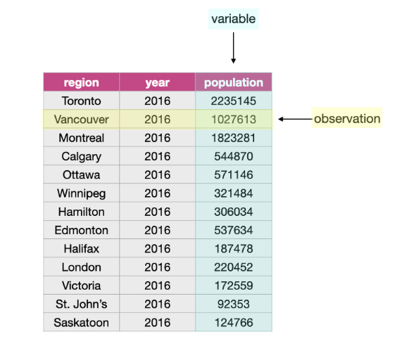
Dataframes
Dataframes are the most common method of storing tabular data
Often, each row is an observations, and column a variable

Slide 6
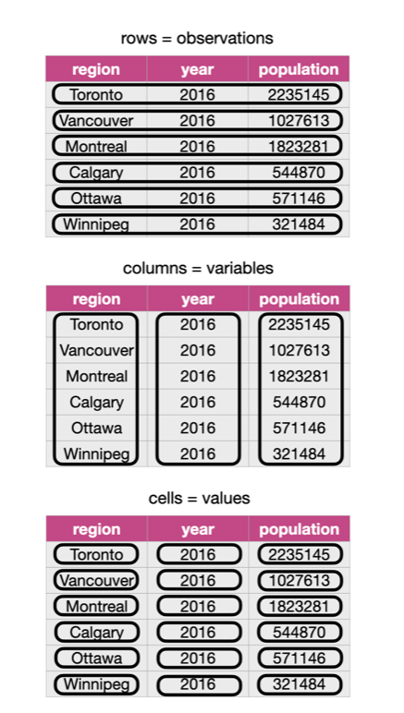
“Tidy” Data
Tidy datasets have the properties:
Each row is a single observation
Each column is a single variable
Each value is a single cell
*In practice, this isn’t always ideal or useful.
For our purposes, it will be.

Slide 7
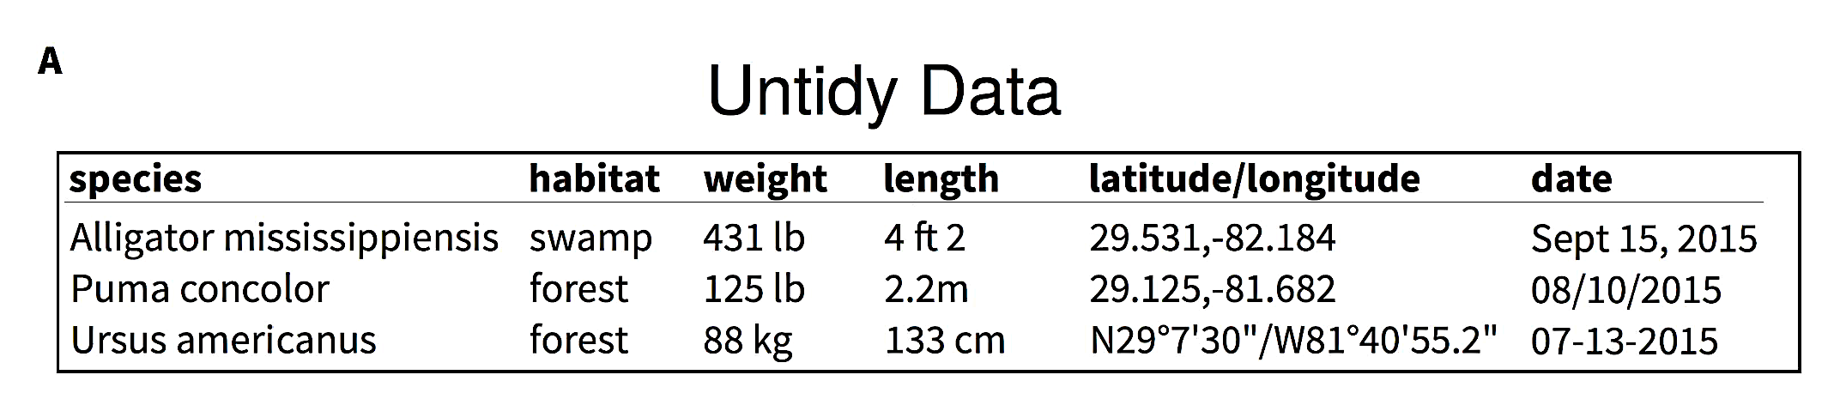
Identify the problems with this dataset

Slide 8
Class 4: Outline
Tufte article discussion
“Tidy” data
Data manipulation with Pandas
Pandas lab
✔️
✔️
👈

Slide 9
To the Code!
Link to notebook!

Slide 10
Class 4: Outline
Tufte article discussion
“Tidy” data
Data manipulation with Pandas
Pandas lab
✔️
✔️
✔️
👈

Slide 11
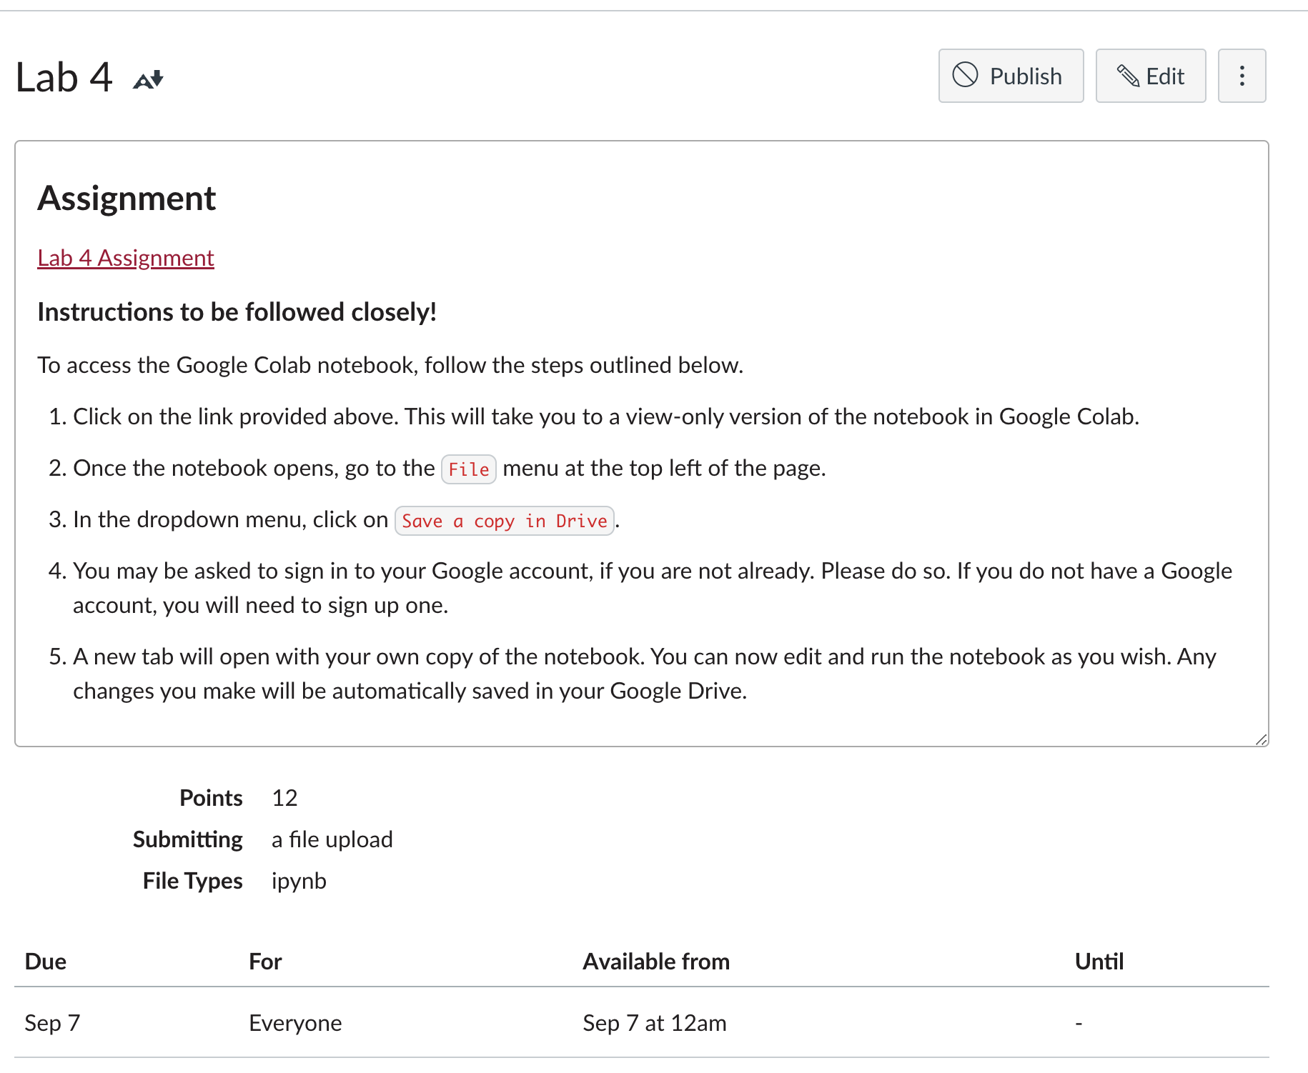
Class 4 Lab

